Slide 1
Justice in the context of Russian armed aggression
January 3-12, 2025

Slide 2
Methodology
Audience: population of Ukraine aged 18 and older in all oblasts, except for the temporarily occupied territories of Crimea and Donbas, as well as areas where Ukrainian mobile communication was not available at the time of the survey. The results are weighted using the latest data from the State Statistics Service of Ukraine. The sample is representative in terms of age, gender and settlement type
Sample population: 2000 respondents
Survey method: CATI (Computer Assisted Telephone Interviewing). Based on a random sample of mobile phone numbers
The margin of error of the study with the confidence interval of 0.95: does not exceed 2,2%
Dates of the survey: January 3-12, 2025.
The survey was conducted at the request of the Center for Human Rights ZMINA.

Slide 3
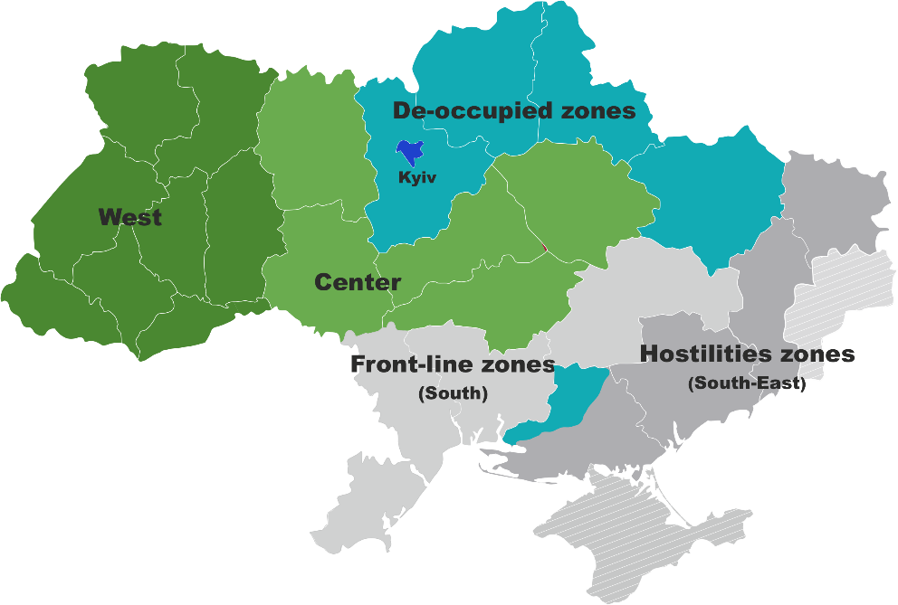
Methodology
Territorial distribution based on the regions where respondents lived before February 24, 2022:
Hostilities zones (partially or fully occupied oblasts in which active hostilities are taking place): Donetsk, Zaporizhzhya, Luhansk oblasts.
Front-line zones (oblasts near the hostilities zone, some of which are subject to constant fire): Dnipropetrovsk, Mykolaiv, Odesa oblasts.
De-occupied zones (regions that were partially occupied): Kyiv, Sumy, Chernihiv, Kharkiv, Kherson oblasts.
West and Center (oblasts that were not occupied (absolutely or almost): Vinnytsia, Volyn, Zhytomyr, Zakarpattia, Ivano-Frankivsk, Kirovohrad, Lviv, Poltava, Rivne, Ternopil, Khmelnytsky, Chernivtsi, Cherkasy oblasts.
Kyiv city designated as separate group due to proximity to military activities until April 2022 and a high level of internal migration.
MACROREGIONES:

Slide 4
Losses caused by the war

Slide 5
What losses have you suffered because of the war?
SEVERAL ANSWERS

Slide 6
Attitude towards lustration

Slide 7
Can lustration be used as one of the tools to restore trust in government institutions after the war?
Regions. Age

Slide 8
If lustration is considered as a mechanism to restrict access to state positions for those who collaborated with the occupation authorities, to whom should it be applied first?
NO MORE THAN 3 ANSWERS

Slide 9
Which government positions should be prohibited for those who had connections with Russia after the start of aggression in 2014?
NO MORE THAN 3 ANSWERS
79

Slide 10
Should Ukrainian lawyers who continued their work in temporarily occupied territories face restrictions on their rights?
Regions. Age

Slide 11
Should Ukrainian lawyers who continued to work in occupied territories face criminal liability?
Regions. Age

Slide 12
Are you aware of the lustration process in Ukraine during 2014-2016?
What is your attitude towards the experience of conducting lustration in Ukraine during 2014-2016?
Among those who are aware or have heard about the lustration process (N=1334)

Slide 13
Who should be responsible for conducting lustration to address the consequences of the war?
Regions. Age

Slide 14
Are you willing to report any information you know about cases of Ukrainian citizens collaborating with occupation authorities to the body conducting lustration?
Regions. Age

Slide 15
Commemoration

Slide 16
In your opinion, what emotions and feelings should places and events for honouring memory evoke?
NO MORE THAN 3 ANSWERS

Slide 17
Which events and actions of Ukrainians in response to Russian aggression should be honoured first?
NO MORE THAN 3 ANSWERS

Slide 18
Which forms of honouring the memory of the Russian-Ukrainian war should be prioritized?
NO MORE THAN 5 ANSWERS

Slide 19
What events or places would you be willing to visit in memory of the war?
NO MORE THAN 3 ANSWERS

Slide 20
Select the statement that best reflects your perspective
Regions. Age

Slide 21
In your opinion, who should decide on events to honour the memory of victims and participants of the Russian-Ukrainian war?
NO MORE THAN 3 ANSWERS

Slide 22
What main tasks should the Ukrainian Institute of National Memory focus on during the ongoing Russian-Ukrainian war?
NO MORE THAN 3 ANSWERS

Slide 23
CONTACTS
Sociological group «RATING»
01010, Kyiv, 20 Esplanadna Street
+380 (95) 578-68-68
+380 (97) 578-68-68
http://ratinggroup.ua/
info@ratinggroup.ua

